Slide 1
Spring Boot Essentials: A Hands-on Journey

Slide 2
PREREQUISITES
Solid understanding of:
Java
OOP
Basic understanding of:
Database
HTTP
Company

Slide 3
CONCEPTS
CODING

Slide 4
Getting Started

Slide 5
HTTP & CRUD
HTTP Methods
POST → Submit data
GET → Read data
PUT → Update existing data
DELETE → Remove data
CRUD Operations
Create → POST /items
Read → GET /items or GET /items/{id}
Update → PUT /items/{id}
Delete → DELETE /items/{id}

Slide 6
EVOLUTION OF JAVA WEB DEVELOPMENT
JSP & Servlets
Spring Framework
Spring Boot
- Hardcoded, verbose
- Manual request handling
- HTML and Java mixed together
- Hard to scale, repetitive boilerplate
- No built-in dependency injection
- Powerful but complex
- Introduced IoC, DI, AOP
- Modular and powerful, but complex configuration
- XML/Java-based bean setup
- Still required manual server deployment
- Simple & modern
- Built on top of Spring
- Auto-configuration, starter dependencies
- Embedded server (Tomcat, Jetty)
- Ideal for REST APIs and microservices

Slide 7
Dependency Management Tools

Slide 8
DEPENDENCY MANAGEMENT IN JAVA
Handles external libraries your project needs
Automatically downloads & links JAR files
Resolves version conflicts
Simplifies build & deployment process

Slide 9
Maven Vs Gradle
Maven | Gradle
XML (pom.xml) | Groovy/Kotlin (build.gradle)
Easier for beginners | More flexible, but steeper learning
Slower (especially clean builds) | Faster with incremental builds & caching
Declarative | Declarative + Imperative

Slide 10
Spring Lifecycle & Project Structure

Slide 11
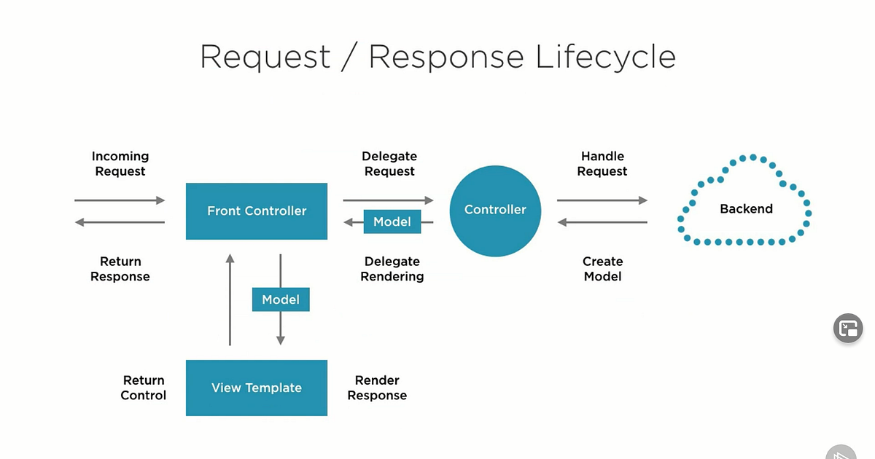

Slide 12
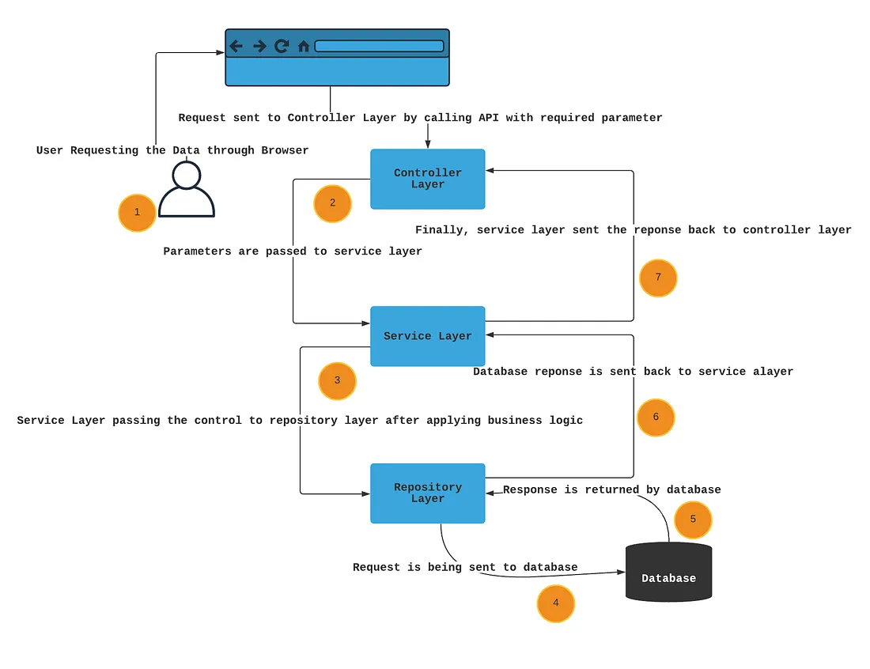

Slide 13
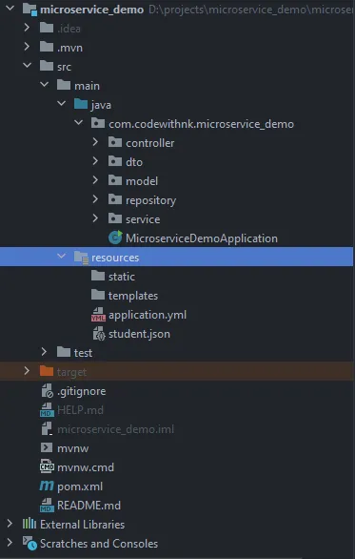
Controller Layer
Contains REST APIs
Service Layer
Contains business logic and models the data for the repository
Takes the data from the repository and sends it back to controller
Repository Layer
Interacts with the database
Model
Represents java objects that define the shape of data, including fields and relationships
DTO
A Data Transfer Object is an object that is used to encapsulate data and send it to UI

Slide 14
Dependency Injection
& Inversion of Control

Slide 15
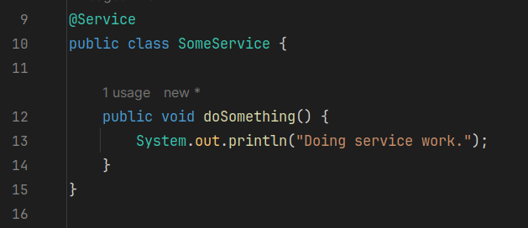
Controller
Service
Repository

Slide 16
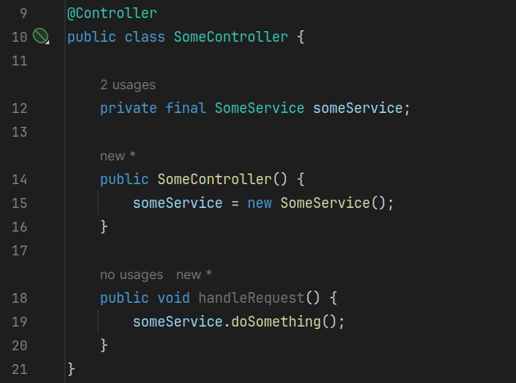
WITHOUT DEPENDENCY INJECTION

Slide 17
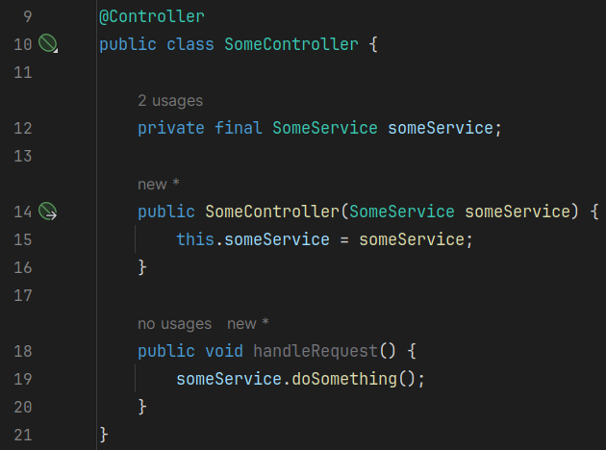
CONSTRUCTOR INJECTION

Slide 18
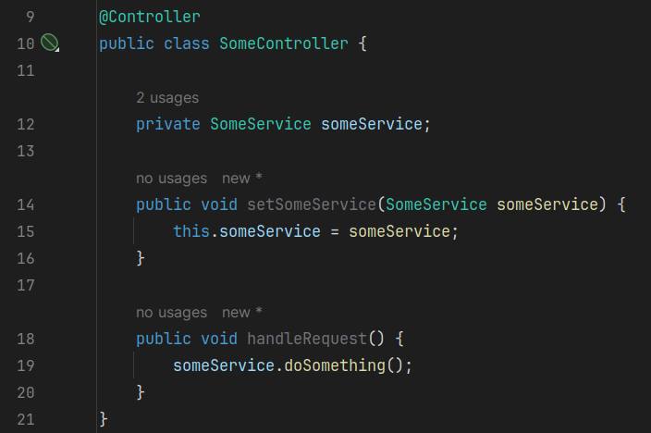
SETTER INJECTION

Slide 19
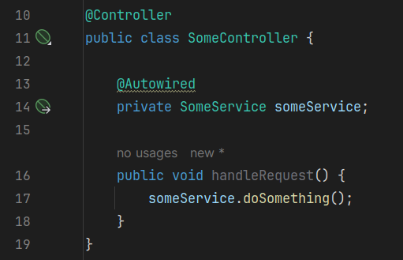
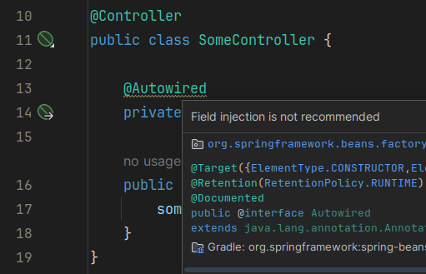
FIELD INJECTION

Slide 20
See It In Action!

Slide 21
Now What?

Slide 22
TOPICS TO EXPLORE
Spring Security
Spring Cloud & Microservices
Spring AI
Unit & Integration Testing
JPA + Query Optimization

Slide 23
HELPFUL RESOURCES
Java: The Complete Reference
OCA / OCP Java SE
Spring in Action
Spring Boot in Action
System Design Interview - An Insider's Guide Vol 1 & 2

Slide 24
REFERENCE
https://github.com/aothoi/ieee-nsu-ias

Slide 25
THANKS!

